Slide 1
Texas Tech University
College Web Tour
College Prep
Mr. Gordon
jgordon@bisdtx.org

Slide 2
Upcoming Events
Fri. Nov. 12th 9th and 10th Texas A&M University Tour. Please check the library window for more information
Fri. Nov. 19th Picture Day
BISD Thanksgiving Break Nov. 22-26 (You still have ACC Monday, Tuesday, and Wednesday)
Sat. Dec. 4th Winter Dance All Grades are Invited
hi

Slide 3

College Web Tours
For the next several weeks, we will be researching various universities around Texas-
both public and private.
Let’s look at Texas Tech University
hi

Slide 4
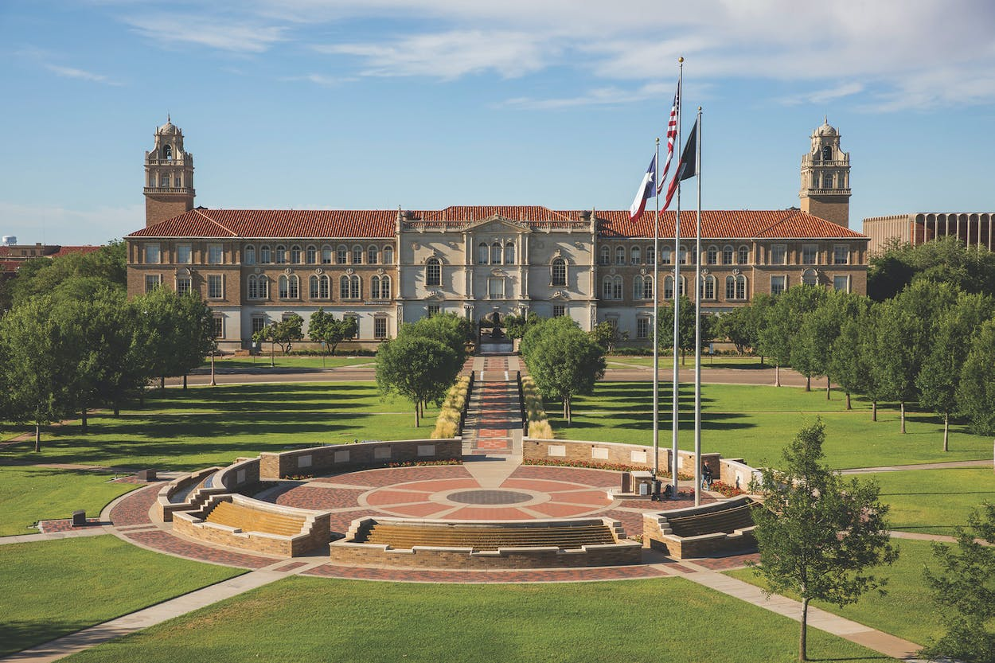

Texas Tech University Facts
Texas Tech is located in Lubbock, TX
6½ hours from CRCA
Texas Tech is a public university.
Texas Tech’s mascot is the Red Raider.
Mrs. Adams graduated from here.
hi

Slide 5
About Texas Tech University
Go to: https://www.ttu.edu/about/
and find the answers to the following questions.
1.How many undergraduate students attend Texas Tech University?
2. Does Texas Tech also offer a law school and medical school?
3. What is the current in-state tuition?
5. How many student organizations does Texas Tech have?
6. Does Texas Tech offer a Study Abroad option?
hi

Slide 6
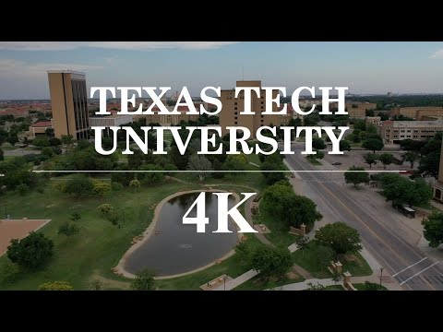
Texas Tech University Drone Tour
Now watch the following video: https://www.youtube.com/watch?v=bsIPZOX_dDY
hi

Slide 7
College Prep Assignment
In the comments section of today’s College Prep,
answer the following question:
What is one thing you liked or disliked about
Texas Tech University?
hi

